Slide 1
Smart Presentation using Hand gesture Recognition
IT416 Computer Vision End-Semester Evaluation
Presented by
Pallapothula Sathvika (201IT141)
Jaya Chandra (201IT123)
Mayur Jinde (201IT135)
Under the guidance of
Prof Dinesh Naik
Assistant Professor
Department of Information Technology
Department of Information Technology
National Institute of Technology Karnataka, Surathkal-575025

Slide 2
CONTENTS
Introduction
Literature Survey
Problem Statement & Objectives
Proposed Methodology
Experimental Results and Analysis
Conclusion
References

Slide 3
Introduction
Gesture recognition is a critical component of human-computer interaction.
Users wish to shift to gesture based systems from the traditional mechanical systems to operate applications in their systems.
PowerPoint presentation can also be performed using gestures instead of using the traditional keyboard, mouse or touchpad to save time.
Users can save a lot of time which is usually wasted in selecting options manually.

Slide 4
Literature Survey
Paper Name | Outcome | Limitation
Power point control using hand gesture recognition based on HOG feature extraction and k-NN classification. | The proposed system effectively enables PowerPoint control through hand gestures using HOG feature extraction and k-NN classification, demonstrating a viable approach for intuitive user interaction. | The system's performance may degrade in complex environmental conditions or with variations in hand gestures not adequately accounted for in the training data.
Multi-feature criteria with fuzzy logic pattern recognition for hand gesture classification | Development of a hand gesture classification system utilizing multi-feature criteria and fuzzy logic pattern recognition, likely aimed at improving accuracy in gesture recognition tasks. | Limited generalization across different users or environments may require recalibration or retraining for each new scenario.

Slide 5
Literature Survey
Paper Name | Outcome | Limitation
Hand Gesture Recognition for Human Computer Interaction. | The paper introduces a marker-less hand gesture recognition system for efficiently tracking both static and dynamic gestures, enabling intuitive human-computer interaction with minimal hardware requirements. | The study lacks comprehensive exploration of potential implementation challenges or limitations, such as accuracy variations under different lighting conditions or the difficulty in recognizing intricate hand movements.
Finger-Pointing Gesture Analysis for Slide Presentation. | The paper likely explores methods for analyzing finger-pointing gestures in slide presentations, potentially offering advancements in gesture detection and interpretation for improving user interaction with presentation software. | Without full-text access, specific limitations are unclear, but common issues in such research may involve challenges in gesture detection accuracy, hardware or software constraints, and potential limitations in generalizability to real-world settings.

Slide 6
Problem Statement & Objectives
Problem Statement:
Developing a system that controls Power-Point Presentation operations using different Hand Gesture through distance.
Objectives:
• We want to create a gesture recognition system that can control a PowerPoint presentation using natural gestures
• To enhance the experience of presentation for presenter as well as listener
• To reduce the user’s physical strain of using mouse and other physical device
• To make the presentation more impactful and seamless

Slide 7
Proposed Methodology
In the proposed model of PowerPoint presentation using hand gesture recognition we divided the methodology in three separate modules in order to thoroughly understand the requirements analysis and gather all the requirements for the development of a complete model.
The different modules are:
• Gesture Selection
• System Design
• GUI Development

Slide 8
Proposed Methodology
Gesture Selection:
Our project utilizes Google's MediaPipe framework for gesture-based control of presentations. This framework, known for its diverse functionalities like real-time object detection and perception systems, employs a graph-based perception pipeline. Hand gestures, detected through this pipeline using webcam input, trigger actions such as navigating slides, drawing, using a pointer, and undoing actions in PowerPoint presentations.

Slide 9
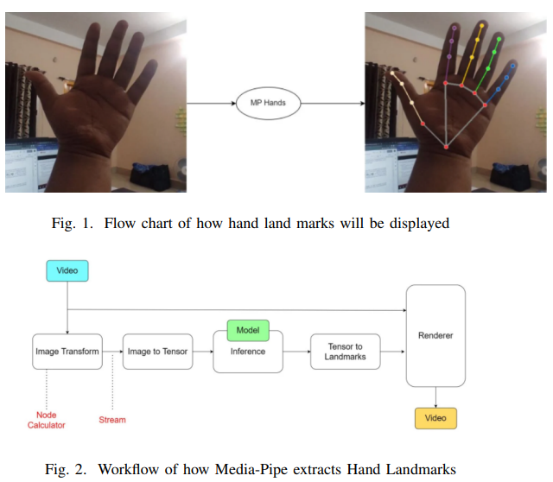
Proposed Methodology

Slide 10
Proposed Methodology (Contd.)
B. System Design:
The system utilizes real-time input from a computer's webcam with a resolution of 1280×720. The captured image is processed by the MediaPipe module to detect hand landmarks, enabling gesture recognition. These gestures are then mapped to corresponding functionalities for controlling PowerPoint presentations.

Slide 11
Proposed Methodology (Contd.)
C. GUI Development:
Our integrated system presents PowerPoint through a web-based graphical user interface. Built using HTML, CSS, and Bootstrap for the front end, Flask API handles the back end with Python, ensuring seamless integration. The web application provides instructions on gesture operations and termination. Users upload their PowerPoint presentations and activate the "power point using hand gesture recognition" feature with a display button.

Slide 12
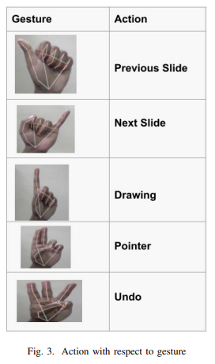
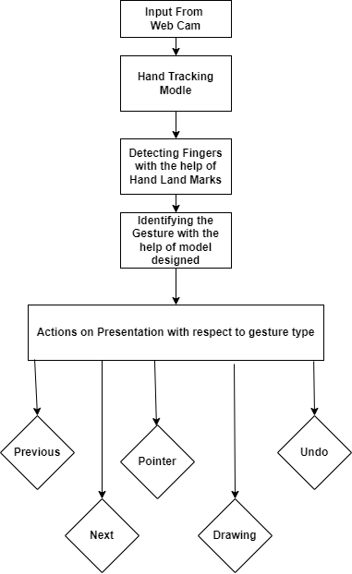
Proposed Methodology (Contd.)
Fig. 4. Flow Chat for gesture recognition

Slide 13
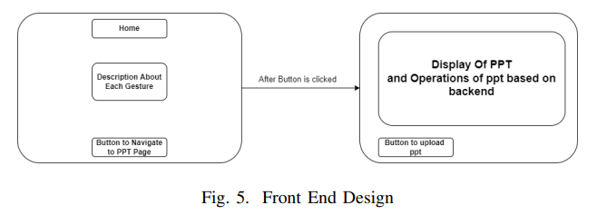
Proposed Methodology (Contd.)

Slide 14
Proposed Methodology (Contd.)
Data Set:
The dataset we plan to use is available online at kaggle
There are 11 gestures in this dataset. There are 3200 samples in this dataset.
RGB image in this dataset have resolution of 640*480 pixels.
The model we plan to implement for gesture recognition is a Multistage Spatial Attention-Based Neural Network.

Slide 15
Experimental Results and Analysis
For Experimental Analysis we tested our product with 30 people and calculated the response time of each gesture when the 30 people were using it. Also we took feedback from them about the performance of the product.
The different tests include:
Likert Test
Product Performance Analysis based on Response Time
Statistical Analysis
Snapshot of results

Slide 16
Experimental Results and Analysis (Contd.)
Likert Test:
The survey had two parts, gathering feedback from users upon initial use and after getting accustomed to the product. There was a clear difference between the two surveys: many found it difficult to use hand gestures at first, but satisfaction increased with familiarity. Those initially dissatisfied later reported satisfaction, indicating a learning curve for using hand gestures. This suggests that integrating hand gestures into product interaction is a new skill for users, requiring time to master.

Slide 17
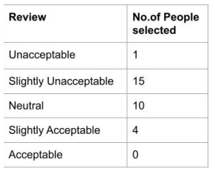
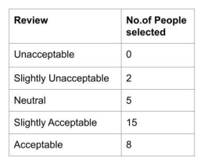
Experimental Results and Analysis (Contd.)
Fig. 6. 1st Survey
Fig. 7. 2nd Survey
(After Getting used to Product)

Slide 18
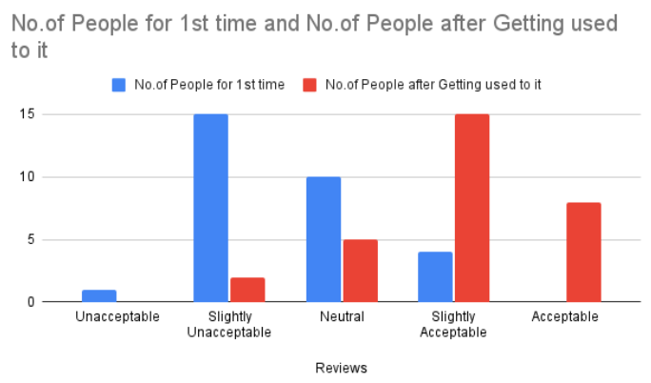
Experimental Results and Analysis (Contd.)
Fig. 8. Comparison

Slide 19
Experimental Results and Analysis (Contd.)
B. Product Performance Analysis based on Response Time:
Response time analysis involves measuring the time taken by users to perform operations, either using hand gestures or a mouse, from a steady position. We conducted 15 trials for each method, recording the time from initiation to completion. After analyzing the data from all 30 trials, we found that the average response time for hand gestures was 1.614666667 seconds, while for the mouse, it was 1.471333333 seconds. The similarity between these averages indicates that the product's performance using hand gestures is comparable to that of using a mouse.

Slide 20
Experimental Results and Analysis (Contd.)
C. Statistical Analysis:
A One-way ANOVA test was conducted to analyze the response times of two user groups categorized by their familiarity with laptop usage and age group. The average response times for each group were compared while performing PowerPoint operations using the product. The F-test-statistic value obtained was 89.57447, surpassing the critical value of 2.89385 at a significance level of 0.10. This indicates a statistically significant difference between the user groups, affirming that they belong to distinct categories based on their familiarity with laptops and age

Slide 21
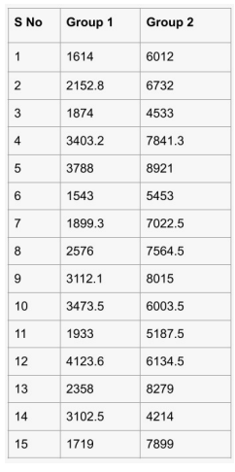
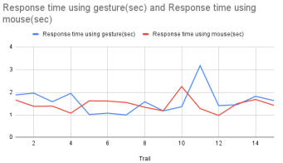
Experimental Results and Analysis (Contd.)
Fig. 9. Response Time of a person in 15 trails
Fig. 10. Average Response times of people in both groups

Slide 22
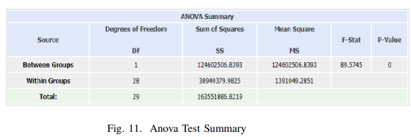
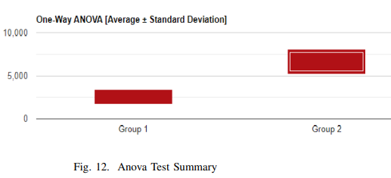
Experimental Results and Analysis (Contd.)

Slide 23
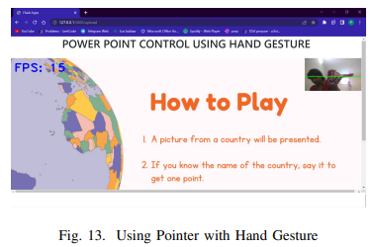
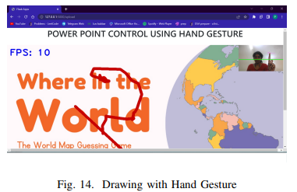
Experimental Results and Analysis (Contd.)
D. Snapshots of result:
Below given snapshots are the final result of our mode in Fig 13 user is accessing the pointer through gesture and in the Fig 14 where user is writing in the power point through drawing feature which is added in the model.

Slide 24
Conclusion
The proposed system introduces a system enabling remote PowerPoint control using only a webcam, without additional hardware.
It utilizes hand landmark detection via MediaPipe for five gestures.
Response time analysis shows minimal difference compared to mouse control, with average times of 1.47133 seconds for the mouse and 1.61466 seconds for the proposed system, indicating comparable efficiency.

Slide 25
References
https://www.semanticscholar.org/paper/Power-point-control-using-hand-gesture-recognition-Salunke-Bharkad/7599de204059b35e41207eb06076fea24305ffdf
https://ieeexplore.ieee.org/stamp/stamp.jsp?tp=&arnumber=7282130&tag=1
https://www.sciencedirect.com/science/article/pii/S1877050917319130
https://www.semanticscholar.org/paper/Finger-Pointing-Gestur-e-Analysis-for-Slide-Harika-Prihatmanto/541d61cfa21af385a7649c2d43b8d04c75aee371

Slide 26
Thank You

